Slide 1
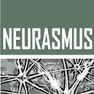


Brain-scale and connectome based-modeling
Workshop - Introduction to Computational Neuroscience
Neurasmus : European Master in Neuroscience
2024 July 3rd - 6th, Amsterdam, Netherlands
Patrick Desrosiers
Dynamica Research Lab
CERVO Brain Research Center
Département de physique, de genie physique et d’optique, Université Laval

Slide 2
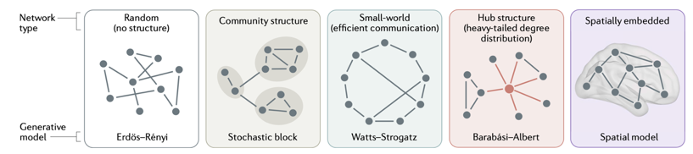
Outline
Graphs
Connectomes
Key properties of connectomes
Density
Clustering
Path distance
Small world
Degree
Motifs
Rich-club
Modules
Low rank
Lynn & Bassett, Nat. Rev. Phys. 2019.

Slide 3
What is a graph?
A graph is a mathematical structure consisting of vertices (nodes) and edges (links) used to model pairwise relationships between objects.
Vertex
Edge
=
=
This is a graph:
This is not a graph:

Slide 4
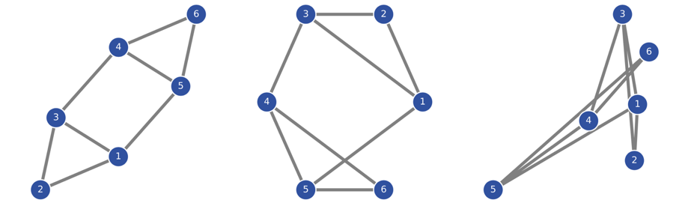
What is the topology of a graph?
The topology of a graph is the arrangement and connections of its vertices and edges.
The topology is preserved under continuous transformations that do not break or alter the edges.
Same graph, same topology, but three different visual representations

Slide 5
There are several types of topologies
Regular
Complex
Random

Slide 6
There are several types of graphs
Simple network
Most studied case
First approximation to any system
Weighted network
Highways
Scientific collaborations
Protein-protein interaction
Directed network
Food web
Streets of a city
Causal relationships
Weighted and directed
Less studied case
Ecosystems
Human relationships
Commercial exchanges
Brain

Slide 7
Matrix representation of a graph:

Slide 8

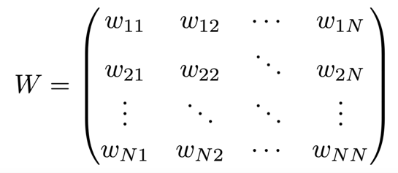



All types of graphs can be encoded into matrices
$$j$$
Beware of the convention for directionality, as it can vary between authors !
Synonyms:
Adjacency matrix
Weight matrix
Connectivity matrix
$$i$$
$$k$$

Slide 9
What is a graph in neuroscience ?
It is a mathematical representation of a neuronal network, where vertices (or nodes) represent neurons or groups of neurons, and edges (or links) represent the synaptic connections or communication pathways between them.

Slide 10
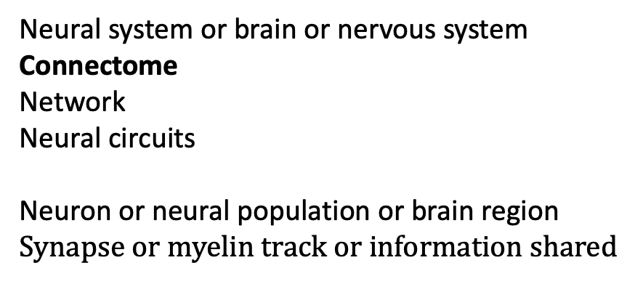

What is a graph in neuroscience ?
Graph
Vertex
Edge
$$≈$$
$$≈$$
$$≈$$
$$≈$$
$$≈$$
$$≈$$
Neural system or brain or nervous system
Connectome
Network
Neural circuits
Neuron or neural population or brain region
$$Synapse or myelin track or information shared$$
Structural connectome (SC)
Functional connectome (FC)
Shu et al., Sci. Rep. 2016

Slide 11
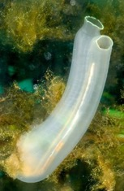
The only complete connectomes
1. Caenorhabditis elegans
Adult hemaphrodite
302 neurons
4885 chemical synapses
White et al., Phil. Trans. R. Soc. Lond. 1986.
Adult male
385 neurons
5315 chemila synapses
Cook et al., Nature 2029.
Yan et al., Nature 2017.
2. Ciona intestinalis
Tadpole larva
177 neurons
6 618 chemical synapses
Ryan et al. eLife 2016
Ryan et al. eLife 2016

Slide 12
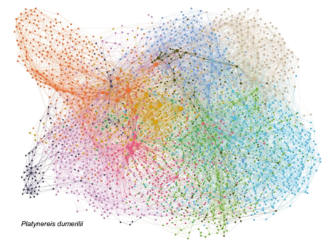
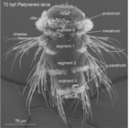
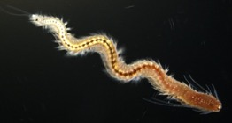

3. Platynereis dumerilii
Larva
2728 neurons
11437 synapses
Verasztò et al., bioRxiv 2020.
Verasztò et al., bioRxiv 2020.
4. Drosophila melanogaster
Adult hemibrane
+ 25k neurons
+ 20M synapses
Data available here

Slide 13
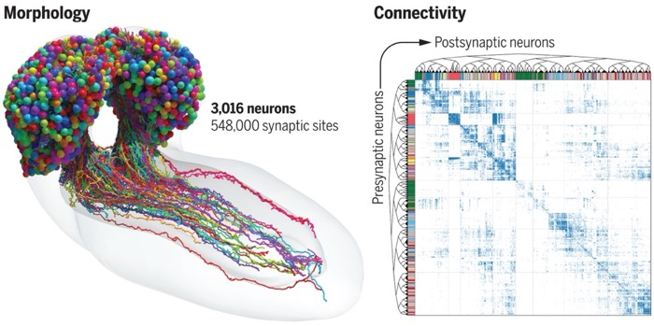
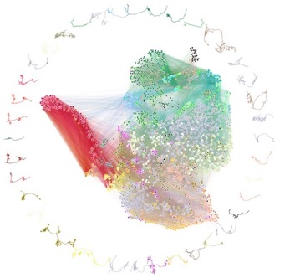
5. Drosophila melanogaster
Larva
3016 neurons
548,000 synapses
Winding et al., Science 2023
Winding et al., Science 2023.
Naddaf, Nature 2023.

Slide 14
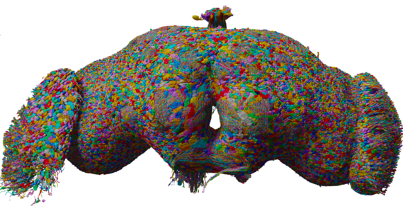
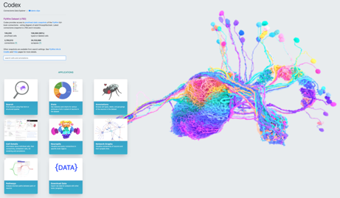
6. Drosophila melanogaster
Adult full brain
127,978 neurons
2,613,129 total thresholded connections
Lin, Yang et al., bioRxiv 2024
Lin, Yang et al., bioRxiv 2024
codex.flywire.ai

Slide 15
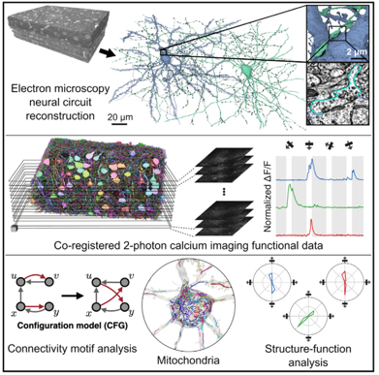
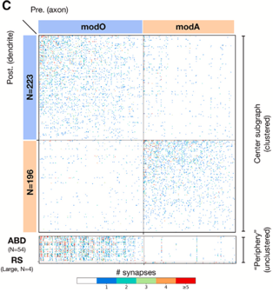
Some incomplete microscopic connectomes
Mouse primary visual cortex
111 neurons
659 connections
Turner et al. Cell 2022
Larva zebrafish brainstem
419 neurons
5,605 connections
Yang et al. Current Biol. 2023
Turner et al. Cell 2022
Yang et al. Current Biol. 2023

Slide 16
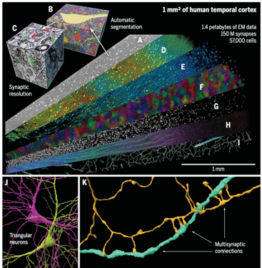
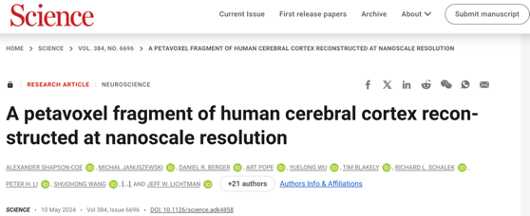
1mm³ of human temporal cortex
57,000 cells, including glia
150 million synapses a
Shapson-Coe et al. Science 2024

Slide 17
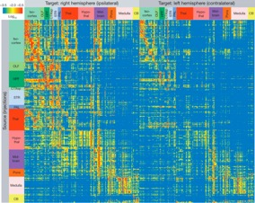
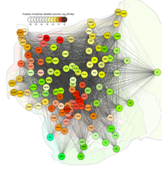
Mesoscopic connectomes
Mouse connectomes
295 brain regions
Oh et al. Nature 2014.
connectivity.brain-map.org
Larval zebrafish
>4000 labels neurons
72 brain regions
Kunst et al. Neuron 2019.
mapzebrain.org
Marmoset cortex
1,968,388 labeled neurons
116 cortical areas
Majka et al. Nat. Commun. 2020.
marmosetbrain.org
https://www.marmosetbrain.org/
Cat, macaque, human …
Online resources: github.com/faskowit/brain-networks-across-the-web
neurodata.io/project/connectomes
networks.skewed.de

Slide 18
First fundamental concepts: density and sparsity
Low density
High density
Sparse graph
Dense graph

Slide 19
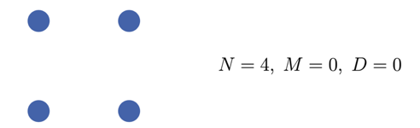
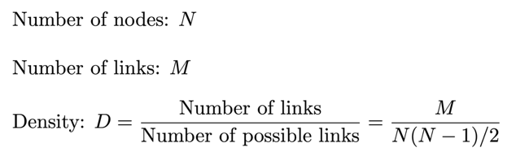
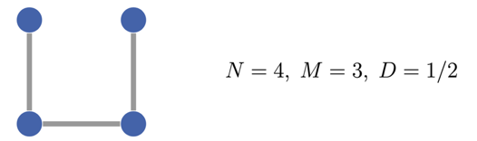
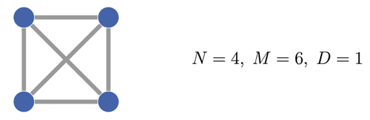
First fundamental concepts: density and sparsity
Density = Connection probability = 1-Sparsity
Increasing density
Increasing sparsity

Slide 20
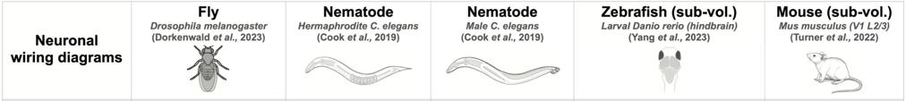
First fundamental concepts: density and sparsity
Connectomes at the microscopic level are typically sparse, with relatively few synaptic connections among the vast number of potential neuronal connections.
Adapted from Li, Yang et al. 2024

Slide 21
Second fundamental concept: clustering
Unclustered graphs:
Clustered graphs:

Slide 22


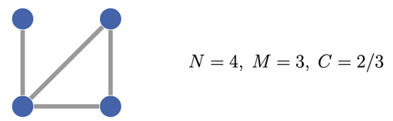
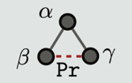
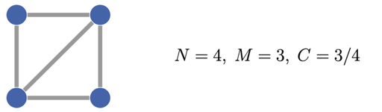
= the probability that for three nodes α, β and γ, given that nodes α and β are connected and nodes α and γ are connected (regardless of directionality), nodes β and γ are connected
= Pr[β∼γ|α∼β∧α∼γ]

Slide 23
Connectomes at the microscopic and mesoscopic levels typically exhibit high clustering
Watts & Strogatz. Nature 1998
Varshney et al. PLoS Comput. Biol. 2011
Van den Heuvel et al. TiCS 2016
Verasztò et al., bioRxiv 2020
Adapted from Li, Yang et al. 2024

Slide 24
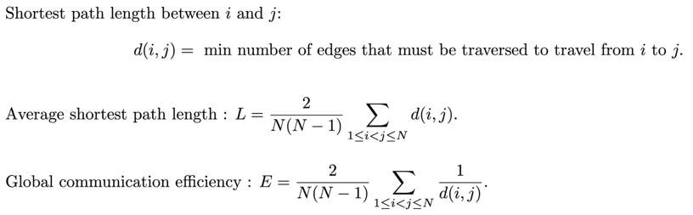
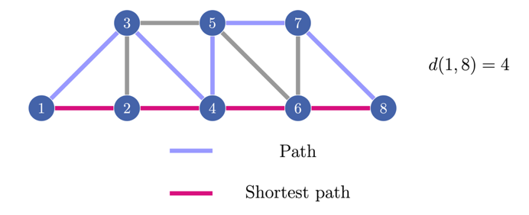
Third fundamental concept: Shortest path length
Distance between 1 and 3 = 1
Distance between 1 and 4 = 3

Slide 25
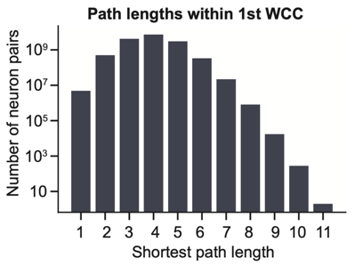

Connectomes at the microscopic and mesoscopic levels typically exhibit low average shortest path length, resulting in high global communication efficiency.
Watts & Strogatz, Nature 1998.
Bullmore & Sporns, Nat. Rev. Neurosci. 2009.
Bassett & Bullmore, The Neuroscientist 2016.
Li, Yang et al. 2024

Slide 26
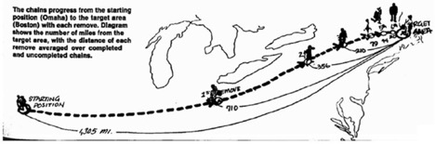
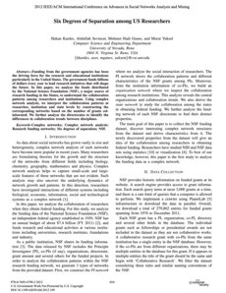
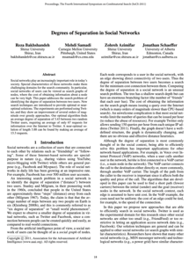
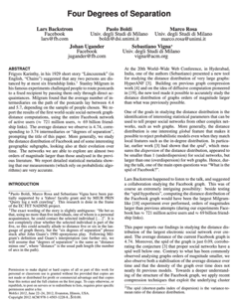
Fourth fundamental concept: Small World
The shortest path length is related to the the degrees of separation in Social Sciences.
Milgram in 1967: people in the US are separated by about six people on average.
Milgram, The small world problem, Psychol. Today 1967
NSF grants: 2.75
Twitter: 3.43
Facebook: 3.74
Six degrees of separation

Slide 27
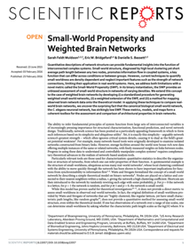
Fourth fundamental concept: Small World
Watts & Strogatz (Nature 1998):
Small-world graphs are characterized by high clustering and a low average shortest path length, meaning that most nodes can be reached from any other node in a few steps while still having densely connected local neighborhoods.
Random graphs have low average shortest path length but are not clustered.
Regular graphs are clustered but have high average shortest path length.
Many real systems (energy transport, actors, C. elegans neuronal network) are small worlds.
Propose a random graph model to generate small worlds.

Slide 28

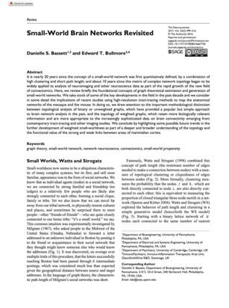
Fourth fundamental concept: Small World
Connectomes at all scales are small worlds, characterized by high clustering and short average path lengths, which are expected to facilitate efficient and robust information transfer.

Slide 29
Fifth fundamental concept: degree
Degree of a node = number of links
= number of neighbors
Degree distribution
degree 1 = 3
degree 2 = 2
degree 3 = 5
degree 4 = 2
degree 5 = 2
degree 6 = 3
Number of nodes
Degree

Slide 30
Homogeneous
Heterogeneous

Slide 31
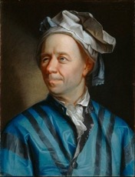
Problem of The Seven Bridges of Königsberg:
Devise a walk through the city that would cross each bridge once and only once .
Euler’s solution in 1736:
No such walk is possible for if there was a walk, then the graph would have exactly zero or two nodes of odd degree.
Königsberg now Kaliningrad
Leonhard Euler (1707-1783)

Slide 32
Unimodal distribution
Heavy-tailed distributions
Source:
Barabasi (2016), Network Science.

Slide 33
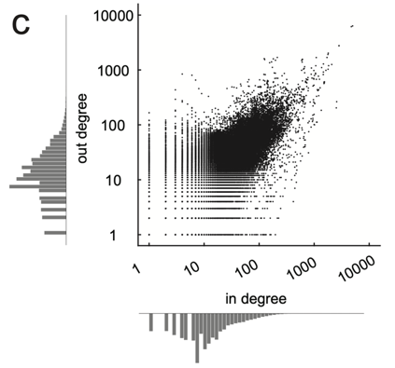
Degree distributions of connectomes are right-skewed and heavy-tailed (Weibull, log-normal, power law).
Hagmann et al. PLOS One 2007. Varshney et al. PLOS Comp. Bio. 2011.
Gastner & Ódor. Sci. Rep. 2016.
Li, Yang et al. 2024.
Li, Yang et al. 2024

Slide 34
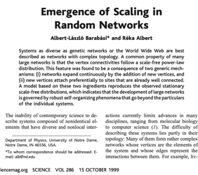
Barabasi & Albert (Science 1999) :
Some real systems (WWW, protein-protein interactions, C. elegans neuronal network) heavy-tailed degree distributions;
A stochastic process to generates heavy-tailed degree distributions (power law) based on preferential attachment.
Networks with such degree distributions are:
Scale-free (fractals).
More robust to random attacks.
More fragile to targeted attacks on hubs.
Spread more easily infectious diseases. Pastor-Satorras et al., Rev. Mod. Phys 2015
Low probability of connection
High probability of connection

Slide 35
Brain growth is not explained by preferential attachment
(homophily)

Slide 36
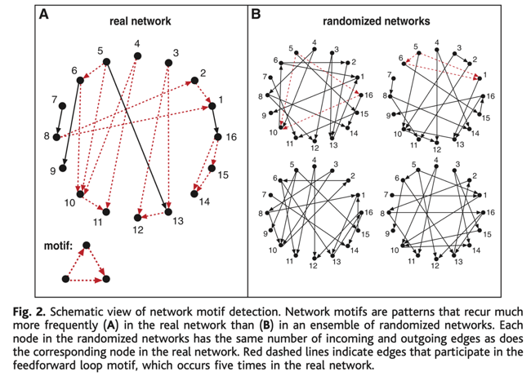
Sixth fundamental concept: motifs
A graph motif is a recurring, significant pattern of interconnections found within a graph, occurring more frequently than expected by chance.
All possible motifs with 3 nodes:
Milo et al., Science 2002.

Slide 37
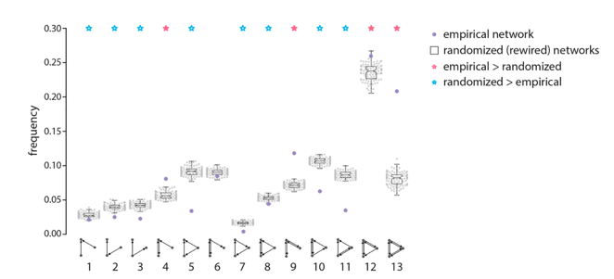
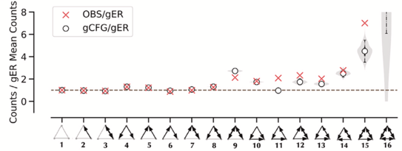
In connectomes, certain motifs are overexpressed compared to what would be expected in randomized networks.
Milo et al., Science 2002.
Sporns et al., PLOS Biology 2004.
Liu et al., Netw. Neurosci. 2020.
Yang et al., Current Biology 2023.
Motifs in marmoset cortex
Motifs in larva zebrafish brainstem
Liu et al., Netw. Neurosci. 2020.
Yang et al., Current Biology 2023

Slide 38
Seventh fundamental concept: rich-club
A rich-club in a graph is a subset of highly connected nodes (hubs) that are more densely interconnected among themselves than with the rest of the network, forming an elite "club”, expected to play a crucial role in maintaining the network's structural integrity and facilitating efficient communication.
Connectomes have rich-clubs
van den Heuvel & Sporns, J. Neuroscience 2011.
Harriger et al. PLOS One 2012.
Liang et al. Cerebral cortex 2017.
Cook et al. Nature 2019.
Lin, Yang et al. bioRxiv 2024.
Harriger et al. PLOS One 2012.
van den Heuvel & Sporns, J. Neuroscience 2011.

Slide 39
Eighth fundamental concept: modularity
A module or community in a graph is a subset of nodes that are more densely connected to each other than to the rest of the network, often representing functional or structural subunits within the overall graph.
Sporns & Betzel, Annu. Rev. Psychol. 2016

Slide 40
Matrix form of community detection:
Permutation of rows and columns

Slide 41

All connectomes have modules or communities.
Sporns & Betzel, Annu. Rev. Psychol. 2016.
Liu et al., Netw. Neurosci. 2020.
Betzel, Connectome Analysis 2023.
Winding et al., Science 2023.
Naddaf, Nature 2023.

Slide 42
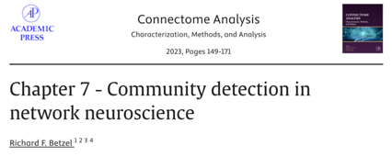
There are several methods to detect modules or communities.
Most methods can be rephrased in the language of the Stochastic Block Model.

Slide 43
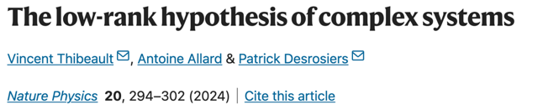


A new concept: effective rank

Slide 44
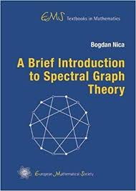
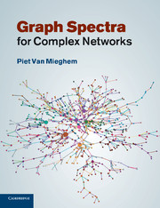
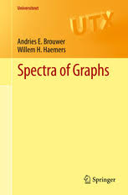
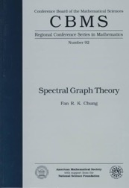
Theoretical framework: Spectral Graph Theory and Matrix factorization
Good sources of information:
Old treasure:

Slide 45
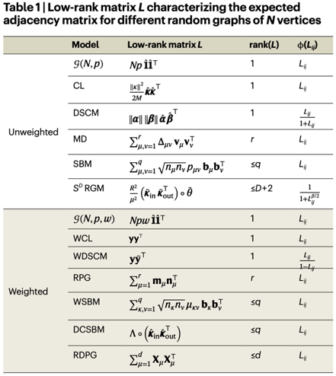
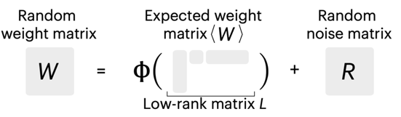



Most network models use low-rank matrices without justification

Slide 46



Why matrix rank? How is it related to dimensionality?
Firing rates
W
largest contribution
smallest contribution
Incoming activity to each neuron

Slide 47















Flags have low rank
Netherlands flag has rank 1
England’s flag has rank 2
=
$$+$$
Nunavik’s flag is more complex
=
$$+$$
High rank, but well approximated with a few singular values.
Approximately low-dimensional.
Need better measures of dimensionality.
$$+$$
$+$ $⋯$
Inspired by a lecture by Alex Townsend on Rapidly Decreasing Singular Values

Slide 48





The effective ranks measure the decrease of singular values

Slide 49


There are many types of singular value decreases

Slide 50


Slide 51

Real network data showed low effective ranks (679 networks)
Caenorhabditis elegans White et al., Phil. Trans. R. Soc. Lond. 1986.
Ciona intestinalis Ryan et al. eLife 2016.
Platynereis dumerilii
Verasztò et al., bioRxiv 2020.
Drosophila melanogaster (adult) Scheffer al., eLife 2020
Drosophila melanogaster (larva)
Winding et al., Science 2023
Mouse (mesoscale) Oh et al. Nature 2014.
Zebrafish (mesoscale) Kunst et al. Neuron 2019.
…

Slide 52


Maturation in C. elegans reduces effective rank
Data from :
Singular values of the matrices describing the connectivity of the C. elegans brain at different maturation stages. Age 1 = 3h post-hatching, Age 5 =23h post-hatching, Age 8 = 45h post-hatching. The stable ranks are 21.6 (age 1), 19.7 (age 5), 18.5 (age 8).

Slide 53
Key Features of Connectomes
Sparsity of connections
High clustering
Small-world phenomenon
Heterogeneous degrees
Overrepresented motifs
Presence of a rich-club
High Modularity
Low effective rank

Slide 54





Other fundamental concepts? Yes, a lot!
Centralities
Network radius and diameter
k-Core decomposition
Assortativity
Local efficiency
Diffusion gradients
…
So far, no topological property has been identified as unique to brain networks.
Yet, brain networks have a unique characteristics: their dynamics.

